Slide 1



TFL Data Pipeline Analytics Hub
Real-Time Data Processing for London Underground Operations Monitoring
Batch Processing Team
Streaming Team
Gharzay, Padma Sri, Kavya
Sylvester, Aamir, Lewis

Slide 2




Purpose of the Project
Build a Batch Data Pipeline
Standardise & Clean
Enable Reporting & Analysis
Create Reusable Framework
●
Ingest Transport for London (TFL) line data from APIs
●
Across raw, staging, and curated layers
●
Line performance: delays, disruptions
●
Extensible for other TFL datasets
●
Ensure reliability and analytics-readiness
●
Into a central data platform
●
Trends by time of day, route, and station
●
Foundation for real-time/streaming use cases
●
Schema-based data preparation
●
For unified data management
●
Actionable business insights
●
Scalable architecture for future growth

Slide 3
Problem Statement
Unstructured & Inconsistent
Raw API output varies across different endpoints with inconsistent formats, data types, and field definitions, making it difficult to integrate and process at scale.
Difficult to Analyse
Mixed timestamp formats, missing values, and varying data structures prevent direct analytics. No unified schema for reliable reporting across tube lines.
3
Not Stored Historically
Real-time data is not persisted, making it impossible to track trends, identify patterns, or analyze long-term performance issues across days and weeks.
Not Optimised for Reporting
Lacks unified data model for business analytics. Cannot easily answer questions about delays by line, route, station, or time-of-day for operational insights.

Slide 4


Key Technology Choices
Data Processing & Transformation
Streaming & Real-Time
Data Storage & Warehousing
●
Python: Data ingestion, data analysis.
Kafka: Real-time data streaming and event processing
●
HDFS: Hadoop Distributed File System for data persistence
●
PySpark: Full load and transformations
Hive: Data warehousing and querying large datasets
●
●
PySpark: Reading Kafka streamed data, storing in HDFS cluster
Shell script & Scoop: Incremental loads
●
●
●
PostgreSQL: Relational Database Management System for ingestion landing zone
HQL: Hive external tables for data exploration and schema management
●
Development & DevOps
●
Git: Version control system for codebase and collaboration
●
Jenkins: CI/CD platform for continuous integration and deployment

Slide 5


Batch Processing Overview
Multi-Layer ELT Pipeline
Data Loading Strategy
Processing & Transformation
●
Bronze → Silver → Gold
●
RawDataExtraction → Fetch data from API in two modes Full & Inc
●
Bronze: Raw data as source of truth.
●
Full + Incremental loads
●
Silver: Cast types, standardize timestamps, duplicates, enrich metadata
●
Schema-based modeling
DataIntegration→ Connect and load data to OLTP Postgres
●
Gold: Star Schema curated
●

Slide 6
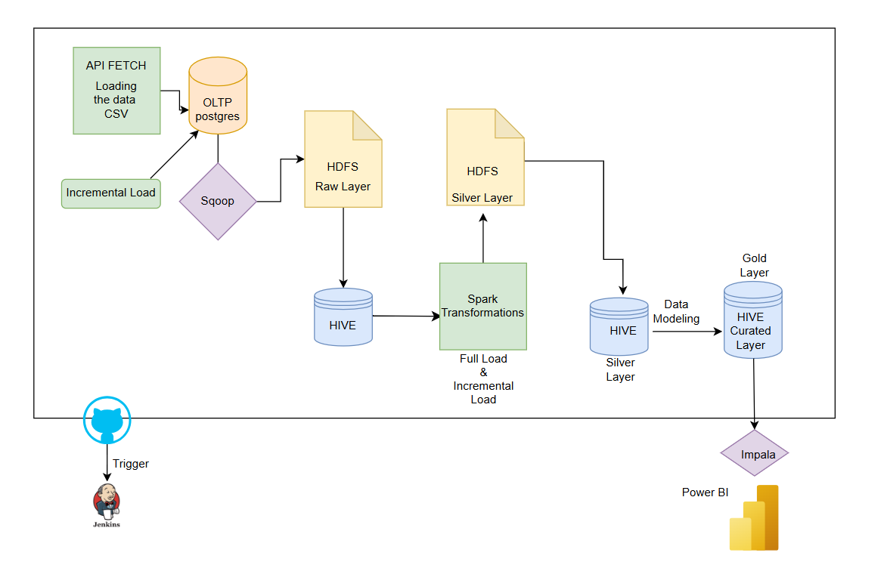
Architecture:

Slide 7






Architecture: Pipeline Data Flow
Stage 1: Data Source
TfL Public API provides real-time operational data for 6 tube lines (Bakerloo, Central, Metropolitan, Northern, Piccadilly, Victoria) with continuous train arrivals and station information updates.
Stage 2: Data Extraction
rawdataextraction.py script calls multiple TfL API endpoints, extracts live arrival data, and saves raw output as CSV files with support for scheduled runs and full and incremental loads.
Stage 3: Data Ingestion
dataintegration.py connects to PostgreSQL database, loads extracted data into Postgres landing zone, performs data validation, logging, and acts as the primary data ingestion module.
Stage 4: Data Transfer
Sqoop extracts data from PostgreSQL database and transfers it into HDFS Bronze Layer. Hive external tables created on Bronze layer for raw data exploration without modifications.
Stage 5: Data Processing
PySpark transformations applied in Silver layer: data type casting, timestamp standardization, duplicate removal, train classification, metadata enrichment, and schema alignment across all 6 tube lines.
Stage 6: Data Modeling
Gold layer implements Star Schema design with fact and dimension tables . Data stored in partitioned Parquet format for optimized performance and analytics readiness.
Stage 7: Query Engine
Hive provides fast interactive querying over the Gold layer Star Schema.
Stage 8: Dashboard
PowerBI connects directly to Gold tables via Impala, delivering cleaned, enriched, business-ready datasets .

Slide 8
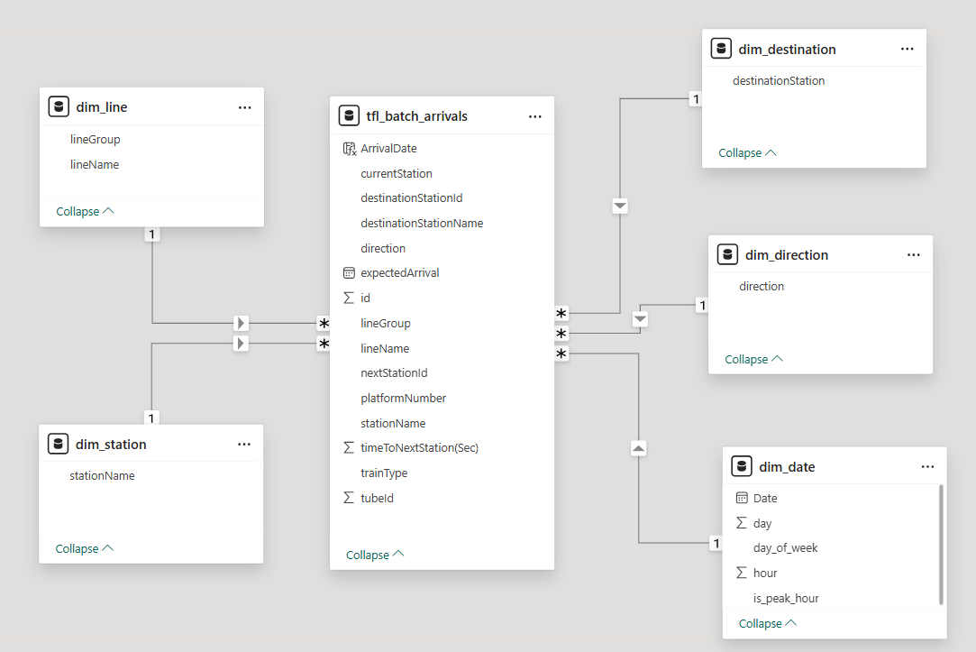
Data Model: Star Schema Design

Slide 9
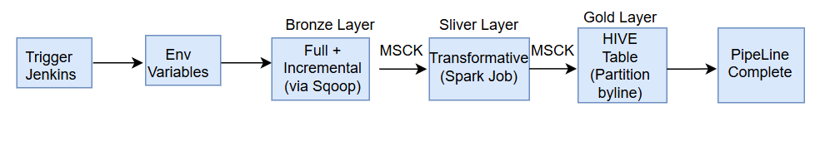
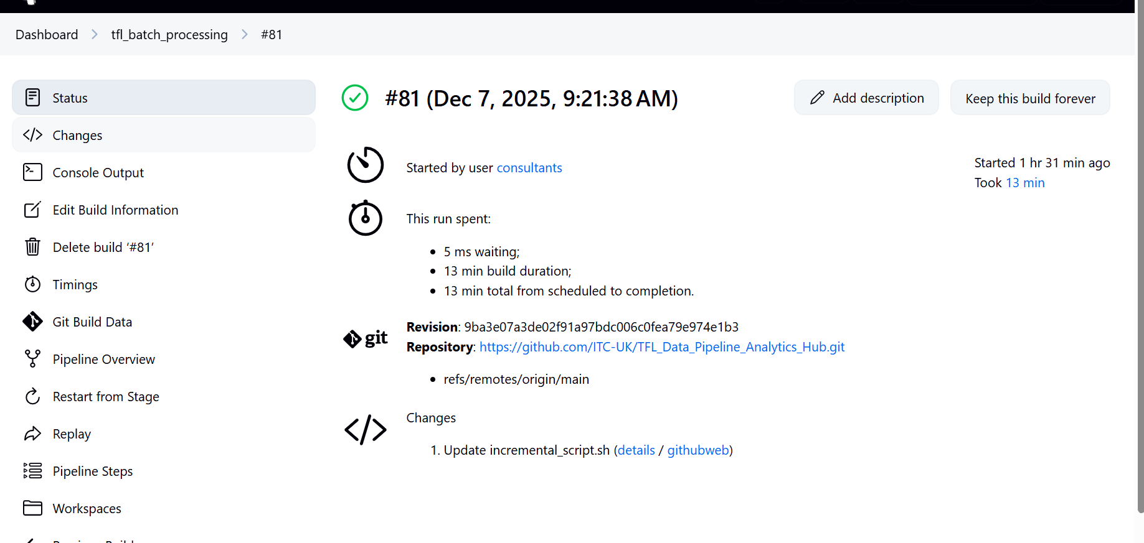
Implementation: Jenkins CI/CD Pipeline
Jenkins Orchestration
●
Auto CI/CD: Extract → Ingest → Sqoop → Silver → Gold
●
Scheduled: Jobs + cron triggers
●
Version Control: GitHub integration
Build Pipeline Steps
●
rawdataextraction.py → TfL API → CSV
●
dataintegration.py → Postgres → Validate
●
Sqoop → Bronze Layer (HDFS)
●
Spark/Hive → Silver transformations
●
Gold Star Schema → Impala
Error Handling
●
Data validation at each step
●
Auto-failure notifications
●
Partition repair: MSCK REPAIR TABLE
●
Graceful recovery

Slide 10
Batch Pipeline Integrations
6
3
10
2
Data Sources
Medallion Layers
Transformations
Outputs
Source Integrations
Processing
Outputs
●
TfL API: 6 lines
●
Transform: Spark (types, duplicates)
●
Query: Impala
●
Scripts: rawdataextraction.py, dataintegration.py
●
Dashboard: PowerBI
●
Model: HiveQL schemas
●
Analysis: Delay trends, peaks, disruptions
●
Landing: PostgreSQL
●
Format: Partitioned Parquet
●
Transfer: Sqoop
●
Enrich: Metadata, classification
●
Monitoring: Alerts
●
Exploration: Hive external tables

Slide 11



Challenges & Solutions (Batch Processing)
Duplicate Records
✓ Solution: Composite unique key (id + stationname + event_time) + dropDuplicates()
Impact: Critical resolution
NULL event_time
✓ Solution: Conditional timestamp parsing (Spark) + standardization
Impact: Data quality fix
Hive Partition Detection
✓ Solution: MSCK REPAIR TABLE command
Impact: System reliability
Schema Mismatch
✓ Solution: Changed schema in Silver transformations and created external table in Hive with matching schema which loads data to PowerBI
Impact: PowerBI compatibility resolved
4
Major Issues Resolved

Slide 12

Key Learnings: Batch Processing
Critical Success Factors
Temporal Data Management
Data Architecture
●
Schema alignment → unified datasets
●
Schema alignment across all lines
●
Composite unique keys → accurate dedup
●
Partitioned Parquet → efficiency & performance
●
Timestamp standardization essential
●
Conditional parsing → mixed format handling
●
Hive partition mgmt → reliability
●
Duplicate detection: composite keys
●
Standardized event_time → analytics-ready
●
External tables → flexible access
●
Partition management critical
●
Validation at each layer prevents cascading failures

Slide 13

Introduction to Streaming
Streaming Objectives
Core Goals
Use Cases
●
Extend batch infrastructure → real-time
●
Live train delay notifications
●
Real-time ingestion & processing
Real-time congestion alerts
●
●
Immediate insights: delays, disruptions
●
Passenger flow monitoring
●
Live operational monitoring (beyond batch)
Alert mechanisms for critical events
●
Anomaly detection
●
●
Dynamic KPI calculations
●
Predictive delay modeling
●
Immediate decision-making
●
Seamless batch integration

Slide 14
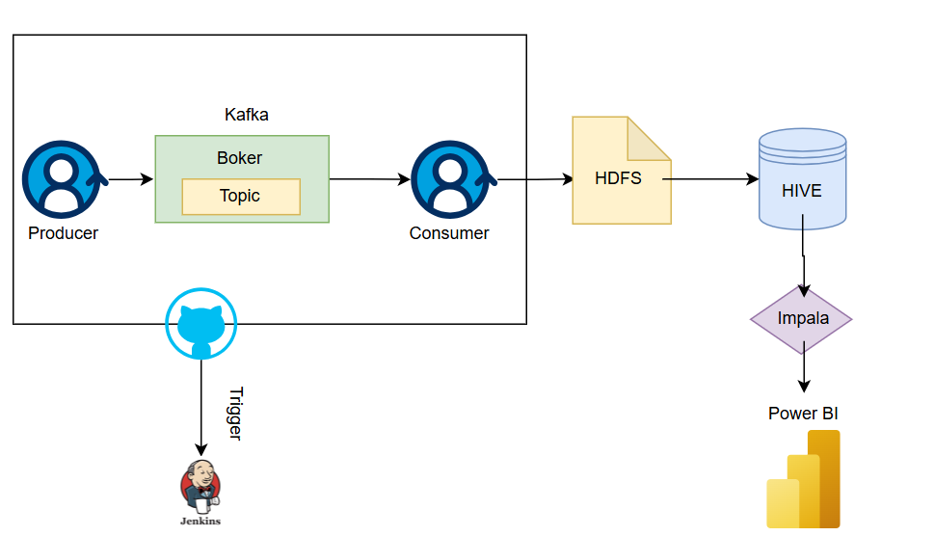
Streaming Architecture Design

Slide 15

Streaming Workflow: End-to-End Real-Time Pipeline
Kafka Source & Ingestion
Processing & Storage
Query & Analytics
●
Impala Query
●
Kafka Topic Source
●
Consumer
Fast interactive queries
Data source
Reads from Kafka topics
PowerBI Dashboard
●
●
Producer
●
HDFS Storage
Real-time visualization & analytics
Writes events to Kafka
Distributed storage layer
●
Kafka Topic Stream
●
Hive External Table
Event stream buffering
Schema layer for HDFS data

Slide 16




Streaming Pipeline Execution (Jenkins)
Trigger (every 5mins)
Refresh Impala Metadata
Start Producer
GitHub integration + cron scheduler. Jenkins job queued and started.
Execute producer.py with Spark. Connect to TfL API. Produce Kafka messages.
. Metadata cache invalidation. Hive/Impala synchronization.
Upgrade pip, Install Dependencies
Start Consumer
Dashboard Updated
Execute consumer.py with Spark. Read Kafka messages. Transform & clean data to HDFS.
PowerBI pulls latest data. Real-time dashboard refresh. Metrics & KPIs ready for consumption.
Upgrade setuptools & wheel. Install all libraries from requirements.txt.

Slide 17


Streaming Integrations
TfL API Integration
Kafka Producer
Kafka Consumer
Data Storage & Query
Producer connected to TfL API
Producer pushes data straight into Kafka topic
Consumer reads live messages from Kafka topics
Spark writes cleaned data into HDFS cluster
Pulls live Tube data every few minutes
Hive/Impala make data available for reporting tools
Real-time data streaming and event buffering
Transforms raw API data into clean, structured format
Real-time data extraction from all 6 lines
Structured format ready for PowerBI consumption
Continuous data flow with minimal latency
Handles deduplication and data validation
Jenkins Orchestration
Jenkins ties everything together for automation
Whole pipeline runs automatically without manual work
Continuous monitoring and error handling

Slide 18
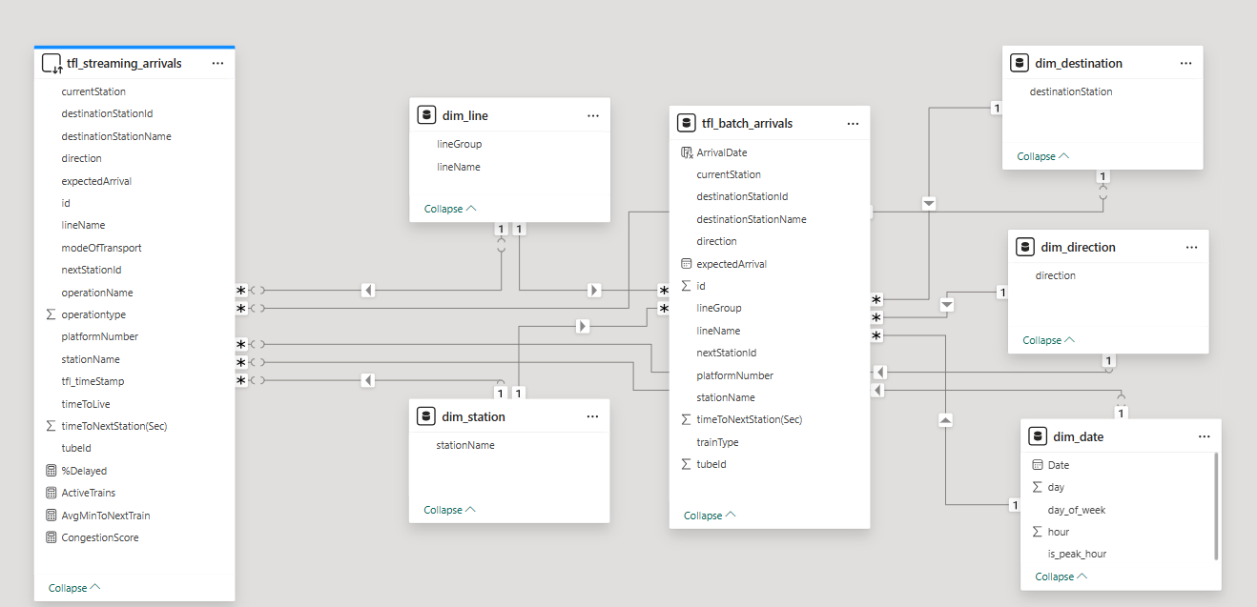
Batch & Streaming Data Model: Star Schema Design

Slide 19


Streaming Challenges: API & Data Quality
API & Data Quality
TfL API data was often slow, incomplete, or inconsistent, requiring retries and extra cleaning to standardise the records.
Streaming & Pipeline Stability
Ensuring reliable Kafka–Spark streaming, keeping only the latest snapshot, and preventing Jenkins jobs from overlapping during 5-minute runs.
File System & Metadata
Power BI wasn't picking up new data until we fixed Hive/Impala metadata by invalidating and refreshing it.
Power BI / DAX Issues
DAX KPIs failed because timestamp fields were stored as text and DirectQuery couldn't fold functions like DATEDIFF/UTCNOW until DateTime and metadata were corrected.

Slide 20
Unit Tests: Producer & Consumer Matrix
Unit Tests
Producer
Consumer
Kafka Creation
Producer setup with correct serializers
Producer setup for consumer
Fetch TFL Data
Returns parsed JSON
Parsed JSON handled correctly
Enrich Events
Adds line metadata & string IDs
Metadata & ID formatting
Send Events
Sends events and flushes producer
Events sent & flushed
Poll and Send Once
End-to-end fetch → enrich → send
Full consumer pipeline tested
Shutdown
Flushes and closes producer
Graceful producer termination

Slide 21
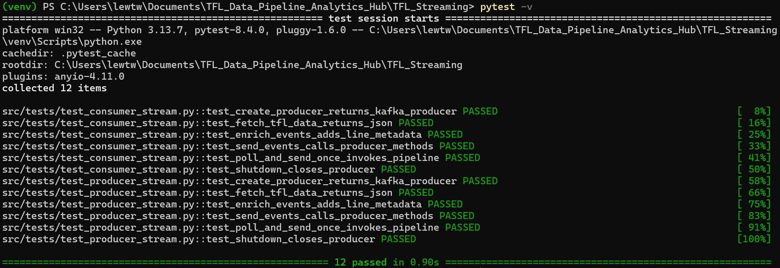
Batch Processing Performance Analysis

Slide 22
Streaming KPIs & Performance Metrics
Real-time health tracking with sub-second latency targets

Slide 23
Batch Processing Performance Analysis
Full Load (27 Nov): 8,000 records processed
Daily Incremental (28 Nov - 3 Dec):500-1,000 records/day/Line

Slide 24



Future Enhancements & Roadmap
Advanced Analytics
Automation & Orchestration
Infrastructure Modernization
●
Machine Learning Predictions
●
Delay trend analysis using ML models
●
Apache Airflow
●
Kubernetes
●
Workflow orchestration and scheduling
●
Container orchestration platform
●
Disruption pattern prediction
●
DAG-based pipeline management
●
Automated scaling and deployment
●
Passenger demand forecasting
●
Automated monitoring and alerting
●
Service mesh integration
●
Peak-hour traffic predictions
●
High availability setup
●
Auto-remediation actions
Mobile app for real-time updates
●
●
Anomaly detection algorithms
●
Dynamic resource allocation
●
Custom alerting rules per user

Slide 25
Q&A

Slide 26

Thank You

